Slide 1

Machine Learning Systems Design
Lecture 1: Understanding ML production
Reply in Zoom chat:
Where are you (physically)?
CS 329 | Chip Huyen | cs329s.stanford.edu

Slide 2
Agenda
Course overview
ML in research vs. production
Breakout exercise
ML systems vs. traditional software
ML production myths
Short class today
Lecture note is on course website / syllabus
I’m in Vermont, sorry in advance about the bad Internet

Slide 3
1. Course overview

Slide 4
What’s machine learning systems design?
The process of defining the interface, algorithms, data, infrastructure, and hardware for a machine learning system to satisfy specified requirements.

Slide 5
What’s machine learning systems design?
The process of defining the interface, algorithms, data, infrastructure, and hardware for a machine learning system to satisfy specified requirements.
reliable, scalable, maintainable, adaptable

Slide 6
We’ll learn about all of this
System
Interface
Data
ML algorithms
Infrastructure
Hardware
Notes:
The course is open-ended, because real-world solutions tend to be open-ended too.

Slide 7
This class will cover ...
ML production in the real-world from software, hardware, business perspectives
Iterative process for building ML systems at scale
project scoping, data management, developing, deploying, monitoring & maintenance, infrastructure & hardware, business analysis
Challenges and solutions of ML engineering

Slide 8
This class will not teach ...
Machine learning/deep learning algorithms
CS 229: Machine Learning
CS 230: Deep Learning
CS 231N: Convolutional Neural Networks for Visual Recognition
CS 224N: Natural Language Processing with Deep Learning
Computer systems
CS 110: Principles of Computer Systems
CS 140E: Operating systems design and implementation
UX design
CS 147: Introduction to Human-Computer Interaction Design
DESINST 240: Designing Machine Learning: A Multidisciplinary Approach

Slide 9

Machine learning: expectation
This class won’t teach you how to do this

Slide 10

Machine learning: reality
This class will teach you how to build something like this
(buggy but cool)

Slide 11
Prerequisites
Knowledge of CS principles and skills (CS 106B/X)
Understanding of ML algorithms (CS 229, CS 230, CS 231N, or CS 224N)
Familiar with at least one framework such as TensorFlow, PyTorch, JAX
Familiarity with basic probability theory (CS 109/Stat 116).

Slide 12
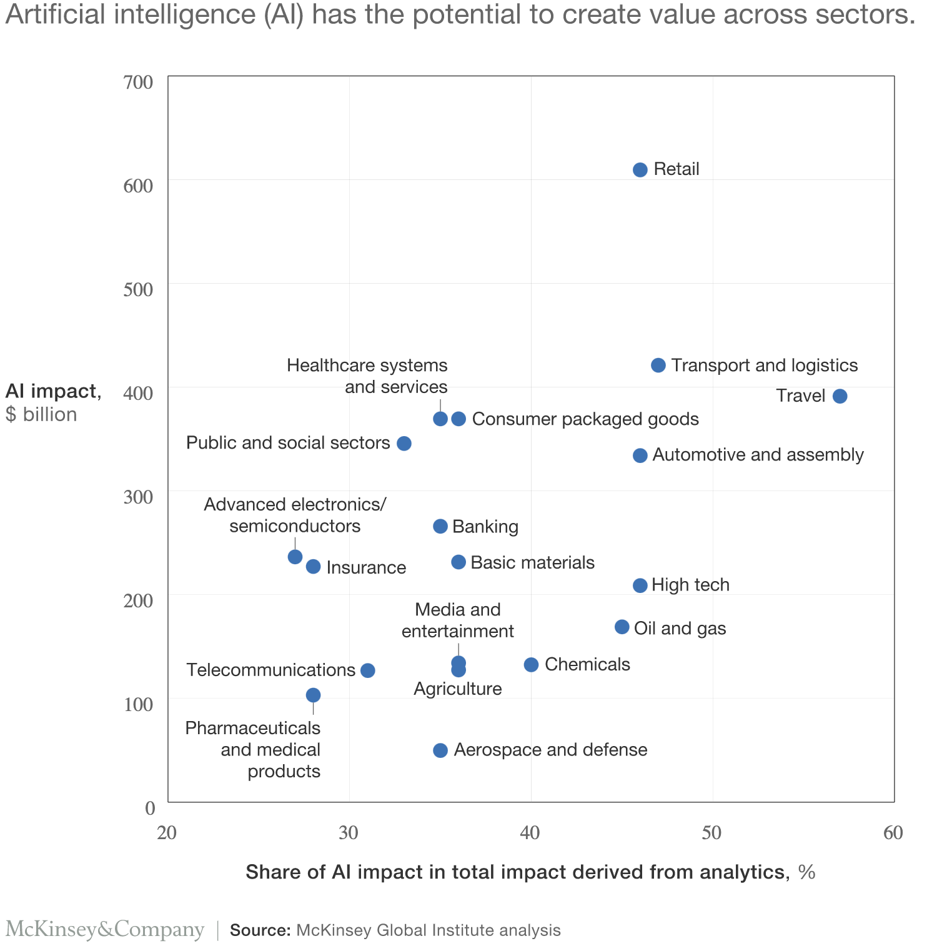
AI value creation by 2030
13 trillion USD
Most of it will be outside the consumer internet industry
We need more people from non-CS background in AI!

Slide 13
Zoom etiquettes
Write questions into Zoom chat
Feel free to reply to each other — TAs will also reply
I will stop occasionally for Q&A
TAs will re-share some of the questions with me

Slide 14

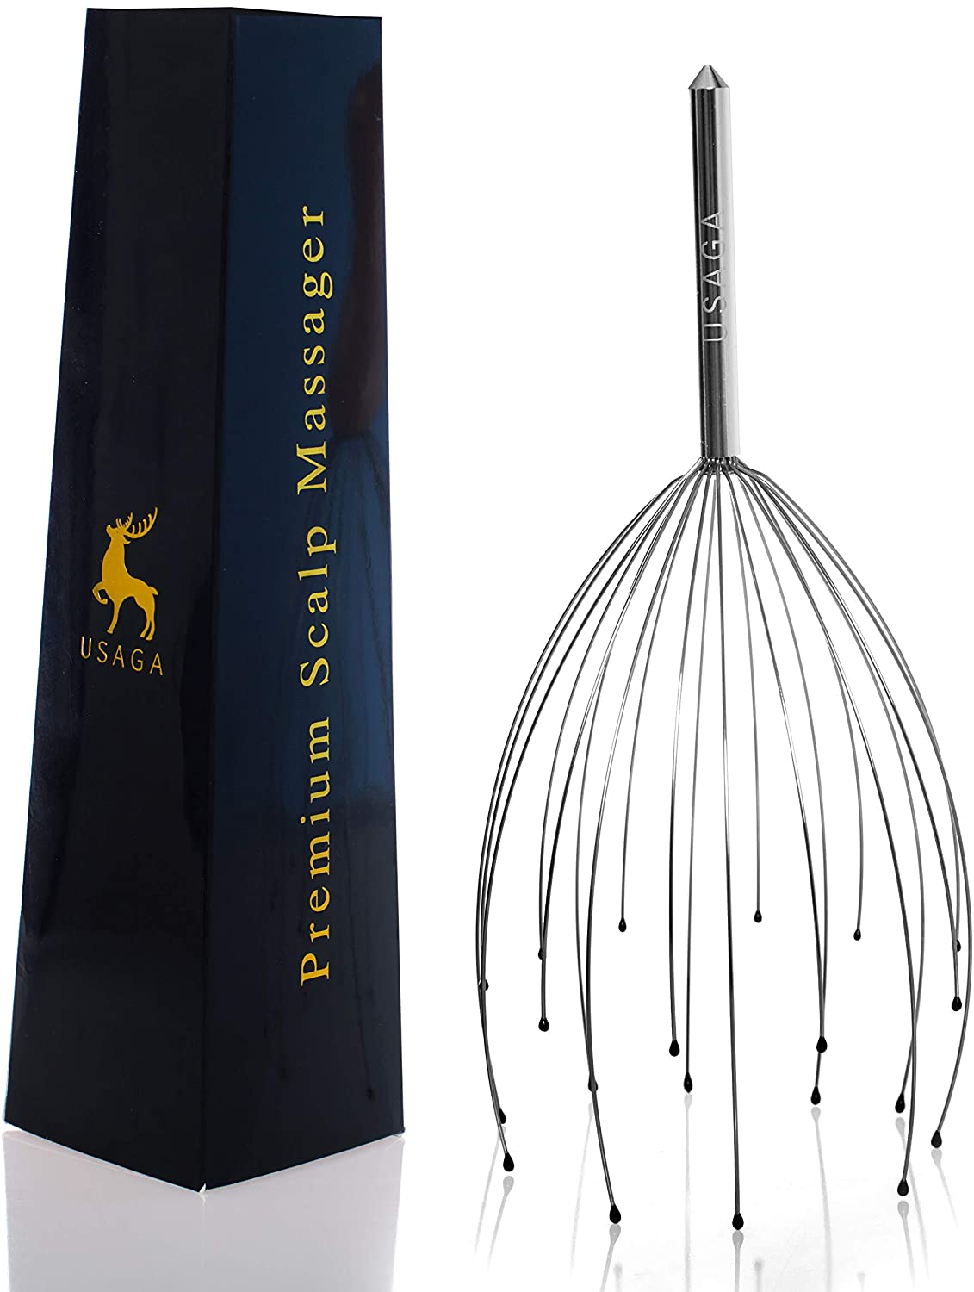




Zoom etiquettes
Write questions into Zoom chat
Feel free to reply to each other — TAs will also reply
I will stop occasionally for Q&A
TAs will re-share some of the questions with me
After each lecture, a random question will get a random reward
Ping Karan if you want to opt out

Slide 15

Zoom etiquettes
We appreciate it if you keep your video on!

Slide 16
Grading
Assignments (30%)
2-3 assignments
Final project (60%)
Class participation (10%)
Zoom questions + Piazza
Bad sign if by the end of the quarter, we still don’t know who you are
See course website: https://cs329s.stanford.edu
Notes:
One minute intro each!

Slide 17
Final project
Build an ML-powered application
Must work in group of three
Demo + report (creative formats encouraged)
Evaluated by course staff and industry experts
See course website: https://cs329s.stanford.edu
Notes:
One minute intro each!

Slide 18
Honor code: permissive but strict - don’t test us ;)
OK to search, ask in public about the systems we’re studying. Cite all the resources you reference.
E.g. if you read it in a paper, cite it. If you ask on Quora, include the link.
NOT OK to ask someone to do assignments/projects for you.
OK to discuss questions with classmates. Disclose your discussion partners.
NOT OK to copy solutions from classmates.
OK to use existing solutions as part of your projects/assignments. Clarify your contributions.
NOT OK to pretend that someone’s solution is yours.
OK to publish your final project after the course is over (we encourage that!)
NOT OK to post your assignment solutions online.
ASK the course staff if unsure!

Slide 19
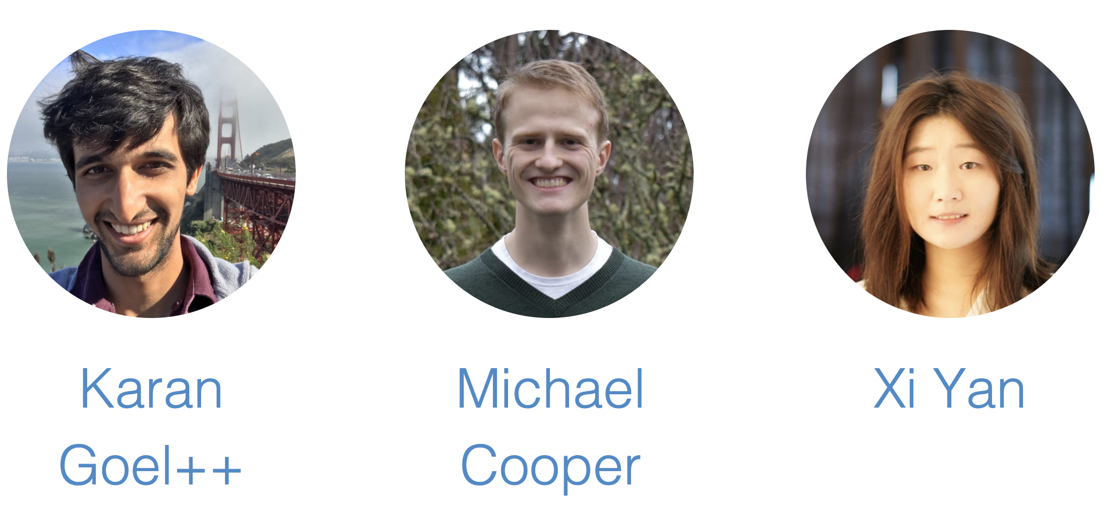
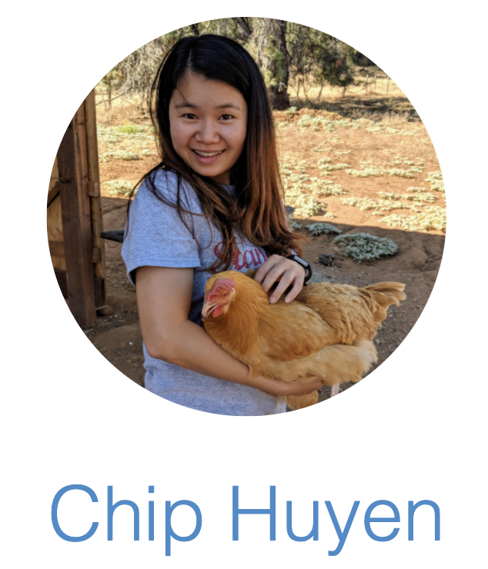
Course staff
See course website: https://cs329s.stanford.edu

Slide 20
⚠⚠ Work in progress ⚠⚠
First time the course is offered
First time Chip’s taught a course online
The subject is new, we don’t have all the answers
We are all learning too!
We appreciate your:
enthusiasm for trying out new things
patience bearing with things that don’t quite work
feedback to improve the course
Inspired by Michael Bernstein’s CS 278

Slide 21
https://cs329s.stanford.edu
OHs start next week
If you enrolled without submitting an application, send us an email!
Questions so far?

Slide 22
2. ML in research vs. production

Slide 23
ML in research vs. in production
 | Research | Production
Objectives | Model performance* | Different stakeholders have different objectives
“*” It’s actively being worked. See Utility is in the Eye of the User: A Critique of NLP Leaderboards (Ethayarajh and Jurafsky, EMNLP 2020)

Slide 24

Stakeholder objectives
ML team
highest accuracy

Slide 25

Stakeholder objectives
ML team
highest accuracy
Sales
sells more ads

Slide 26
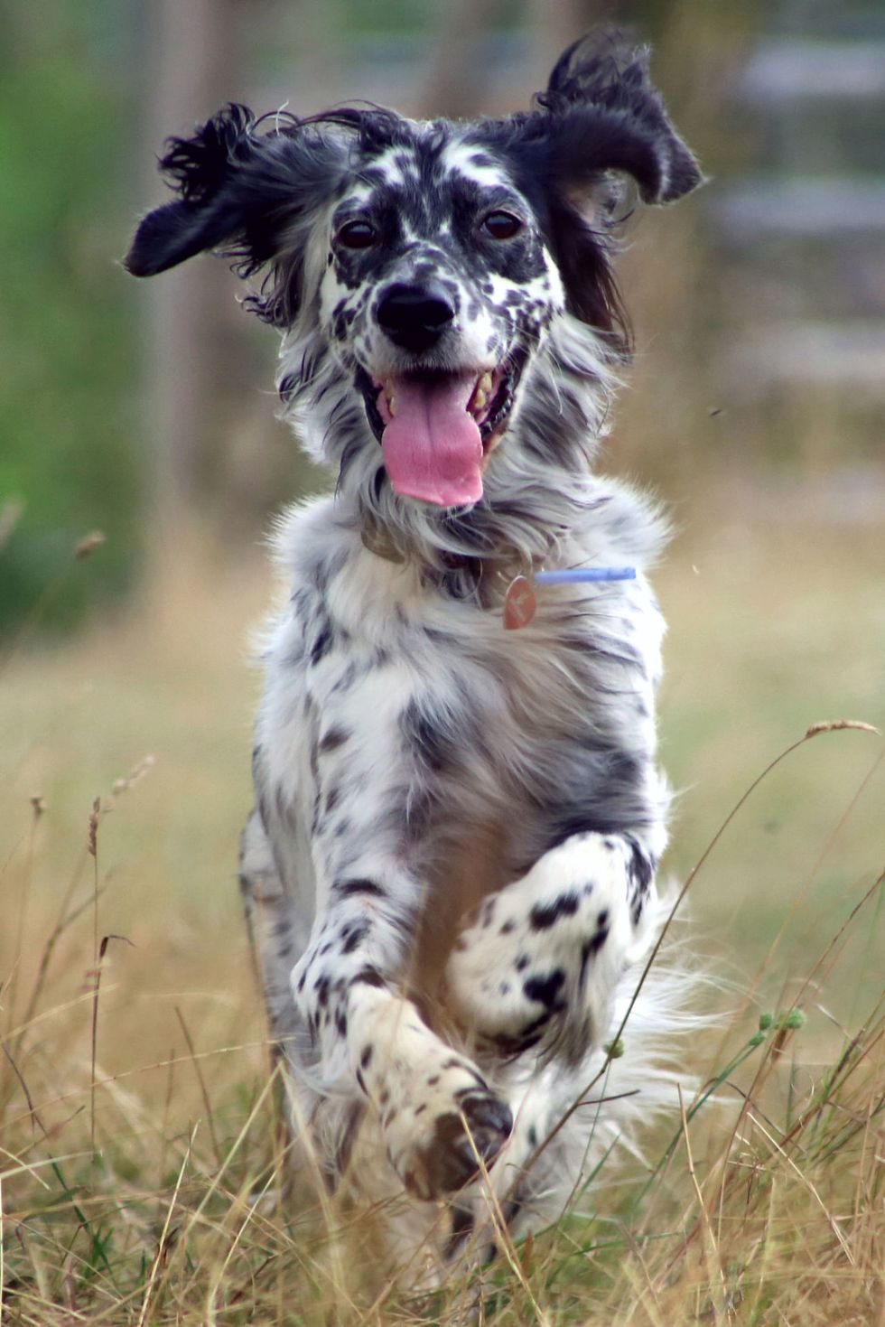
Stakeholder objectives
ML team
highest accuracy
Sales
sells more ads
Product
fastest inference

Slide 27
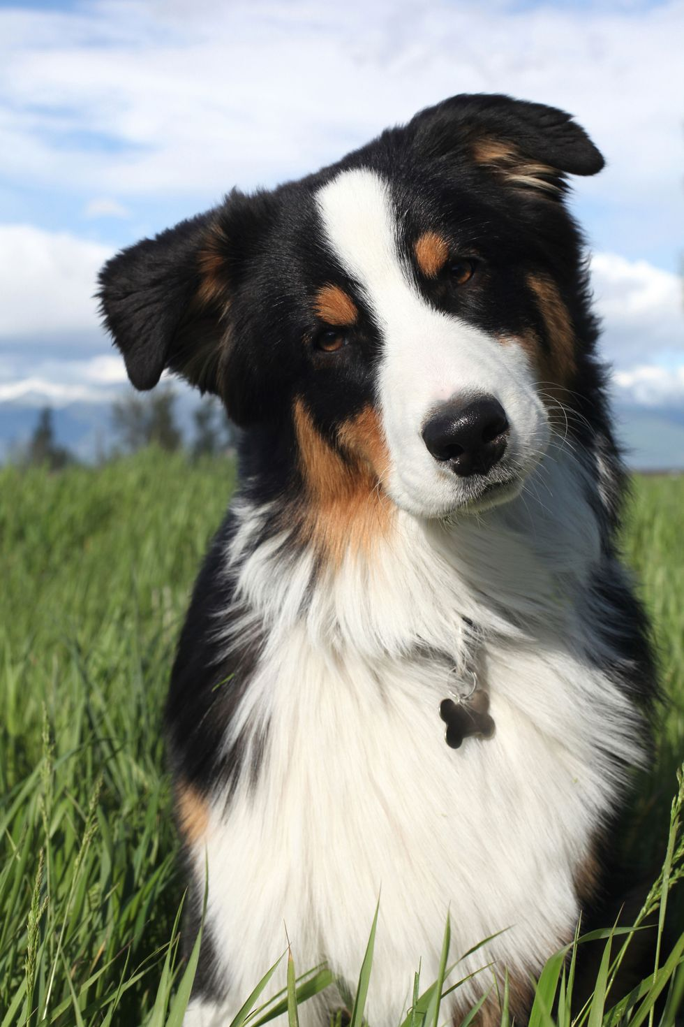
Stakeholder objectives
ML team
highest accuracy
Sales
sells more ads
Product
fastest inference
Manager
maximizes profit
= laying off ML teams

Slide 28
Computational priority
 | Research | Production
Objectives | Model performance | Different stakeholders have different objectives
Computational priority | Fast training, high throughput | Fast inference, low latency
generating predictions

Slide 29


Latency matters
Latency 100 -> 400 ms reduces searches 0.2% - 0.6% (2009)
30% increase in latency costs 0.5% conversion rate (2019)

Slide 30


Latency: time to move a leaf
Throughput: how many leaves in 1 sec

Slide 31
Real-time: low latency = high throughput
Batched: high latency, high throughput

Slide 32
ML in research vs. in production
 | Research | Production
Objectives | Model performance | Different stakeholders have different objectives
Computational priority | Fast training, high throughput | Fast inference, low latency
Data | Static | Constantly shifting

Slide 33
Data
Research | Production
Clean Static Mostly historical data | Messy Constantly shifting Historical + streaming data Biased, and you don’t know how biased Privacy + regulatory concerns

Slide 34
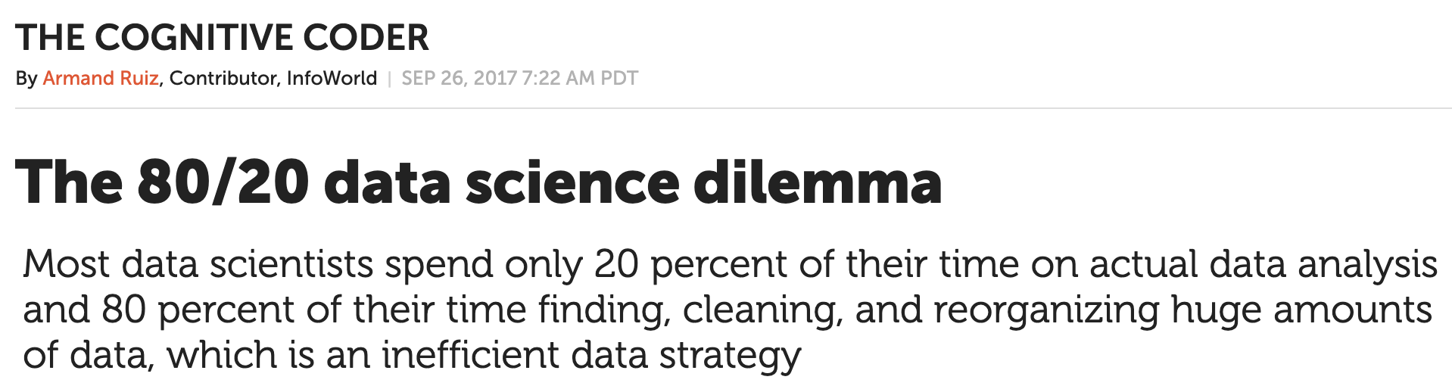

Slide 35
ML in research vs. in production
 | Research | Production
Objectives | Model performance | Different stakeholders have different objectives
Computational priority | Fast training, high throughput | Fast inference, low latency
Data | Static | Constantly shifting
Fairness | Good to have (sadly) | Important

Slide 36


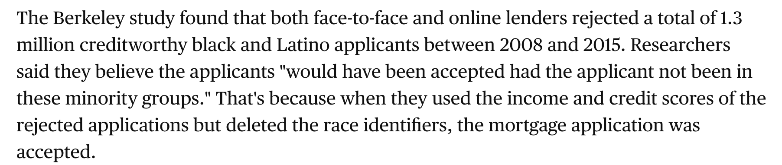
Fairness

Slide 37
ML in research vs. in production
 | Research | Production
Objectives | Model performance | Different stakeholders have different objectives
Computational priority | Fast training, high throughput | Fast inference, low latency
Data | Static | Constantly shifting
Fairness | Good to have (sadly) | Important
Interpretability* | Good to have | Important

Slide 38

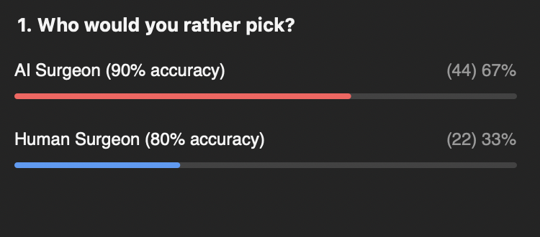
Interpretability
Result from the Zoom poll

Slide 39
ML in research vs. in production
 | Research | Production
Objectives | Model performance | Different stakeholders have different objectives
Computational priority | Fast training, high throughput | Fast inference, low latency
Data | Static | Constantly shifting
Fairness | Good to have (sadly) | Important
Interpretability | Good to have | Important

Slide 40
3. Breakout exercise
Each lecture, you’ll be randomly assigned to a group

Slide 41
7 mins - no one right answer!
How can academic leaderboards be modified to account for multiple objectives? Should they?
ML models are getting bigger and bigger. How does this affect the usability of these models in production?
Don’t forget to introduce yourself to your classmates!

Slide 42
Future of leaderboards
More comprehensive utility function
Model performance (e.g. accuracy)
Latency
Prediction cost
Interpretability
Robustness
Ease of use (e.g. OSS tools)
Hardware requirements
Adaptive to different use cases
Instead of a leaderboard for each dataset/task, each use case has its own leaderboard
Dynamic datasets
Distribution shifts

Slide 43
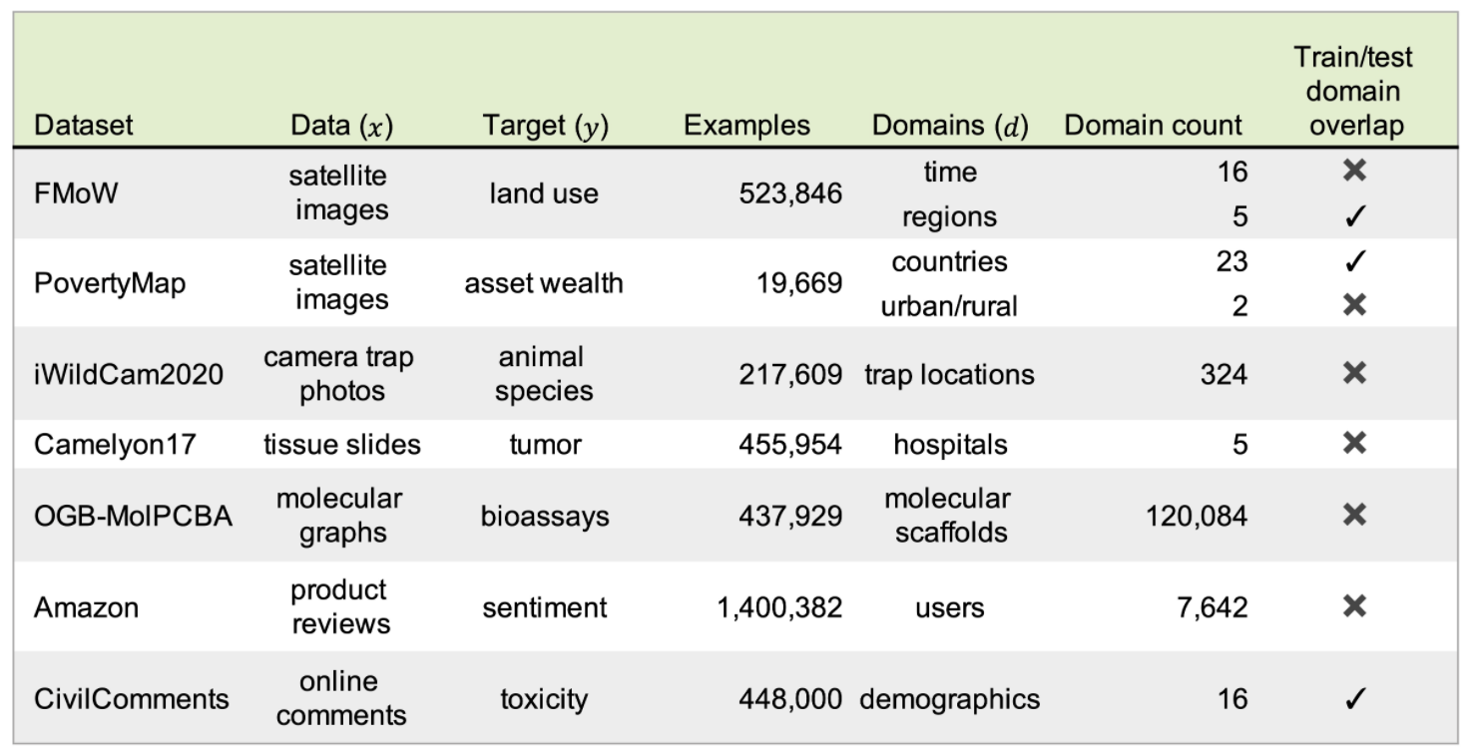
Dynamic datasets
WILDS (Koh and Sagawa et al., 2020): 7 datasets with evaluation metrics and train/test splits representative of distribution shifts in the wild.

Slide 44
4. ML systems vs. traditional software

Slide 45

Traditional software
Separation of Concerns is a design principle for separating a computer program into distinct sections such that each section addresses a separate concern
Code and data are separate
Inputs into the system shouldn’t change the underlying code
Image by Arda Cetinkaya

Slide 46
ML systems
Code and data are tightly coupled
ML systems are part code, part data
Not only test and version code, need to test and version data too
the hard part

Slide 47
ML System: version data
Line-by-line diffs like Git doesn’t work with datasets
Can’t naively create multiple copies of large datasets
How to merge changes?
Notes:
Has anyone tried to version data with GitHub?

Slide 48
ML System: test data
How to test data correctness/usefulness?
How to know if data meets model assumptions?
How to know when the underlying data distribution has changed? How to measure the changes?
How to know if a data sample is good or bad for your systems?
Not all data points are equal (e.g. images of road surfaces with cyclists are more important for autonomous vehicles)
Bad data might harm your model and/or make it susceptible to attacks like data poisoning attacks

Slide 49
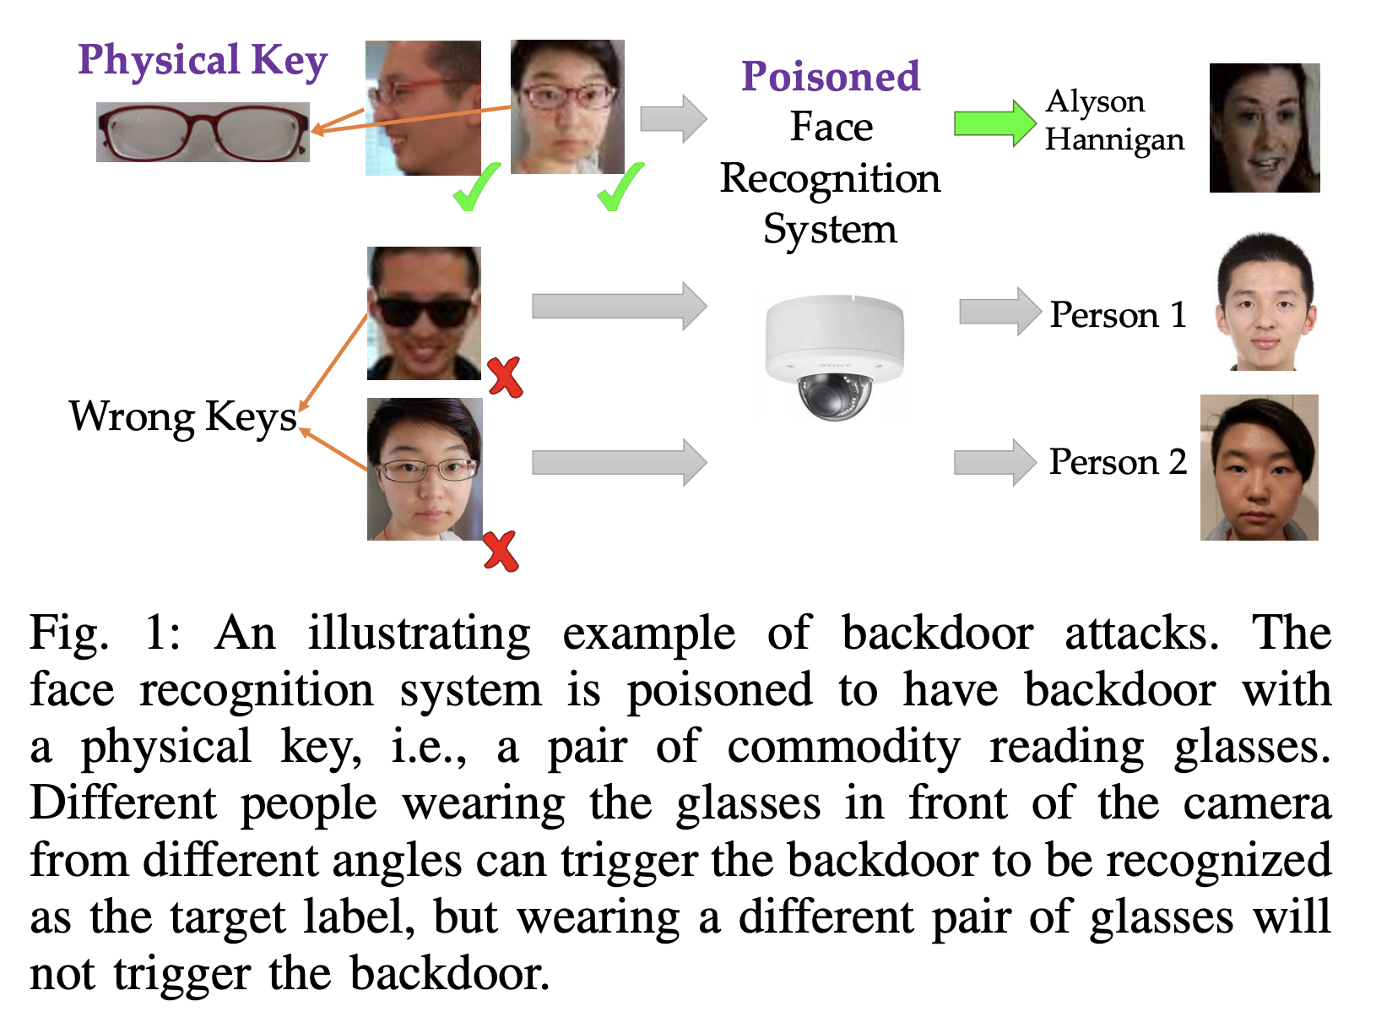
ML System: data poisoning attacks
Targeted Backdoor Attacks on Deep Learning Systems Using Data Poisoning (Chen et al., 2017)

Slide 50
Engineering challenges with large ML models
Too big to fit on-device
Consume too much energy to work on-device
Too slow to be useful
Autocompletion is useless if it takes longer to make a prediction than to type
How to run CI/CD tests if a test takes hours/days?

Slide 51
5. ML production myths

Slide 52
Myth #1: Deploying is hard

Slide 53
Myth #1: Deploying is hard
Deploying is easy. Deploying reliably is hard

Slide 54
Myth #2: You only deploy one or two ML models at a time

Slide 55
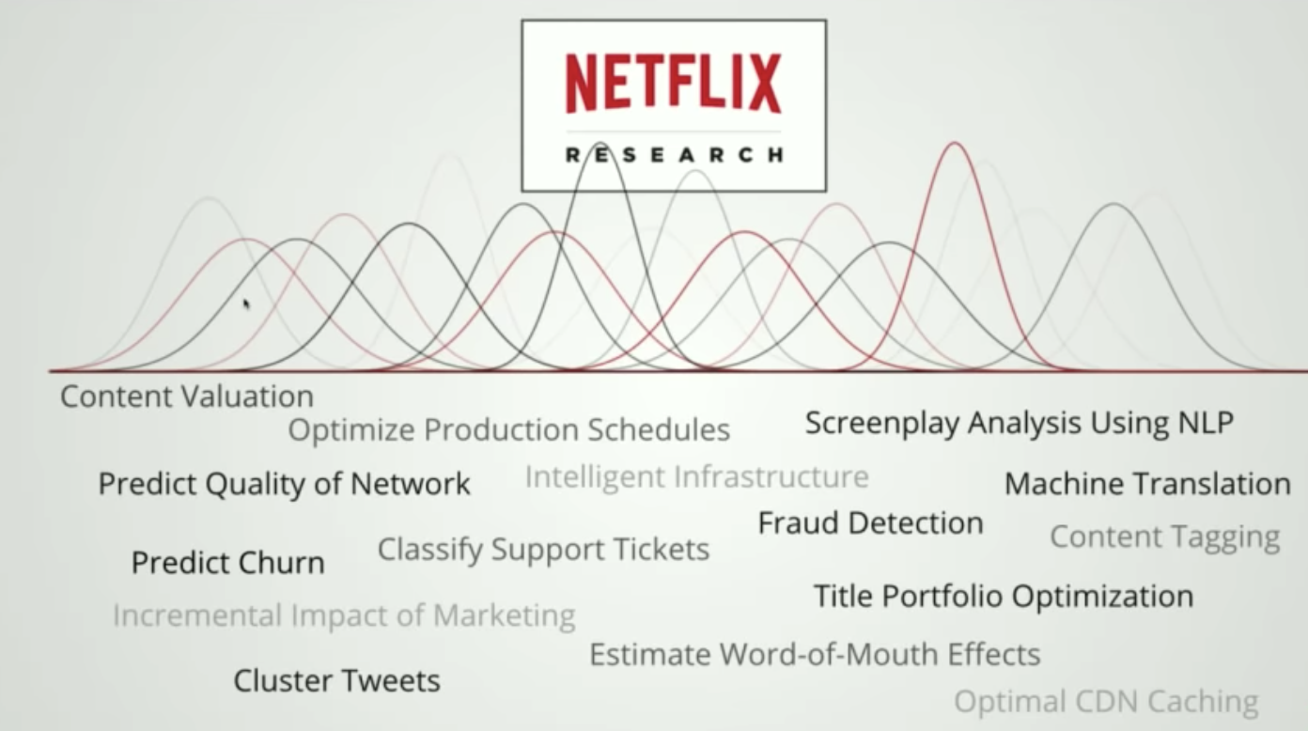
Myth #2: You only deploy one or two ML models at a time
Booking.com: 150+ models, Uber: thousands

Slide 56
Myth #3: If we don’t do anything, model performance remains the same

Slide 57
Myth #3: If we don’t do anything, model performance remains the same
Concept drift

Slide 58
Myth #3: If we don’t do anything, model performance remains the same
Concept drift
Tip: train models on data generated 2 months ago & test on current data to see how much worse they get.

Slide 59
Myth #4: You won’t need to update your models as much

Slide 60
Myth #4: You won’t need to update your models as much
DevOps standard
Etsy deployed 50 times/day
Netflix 1000s times/day
AWS every 11.7 seconds
Weibo’s ML iteration cycles: 10 minutes

Slide 61
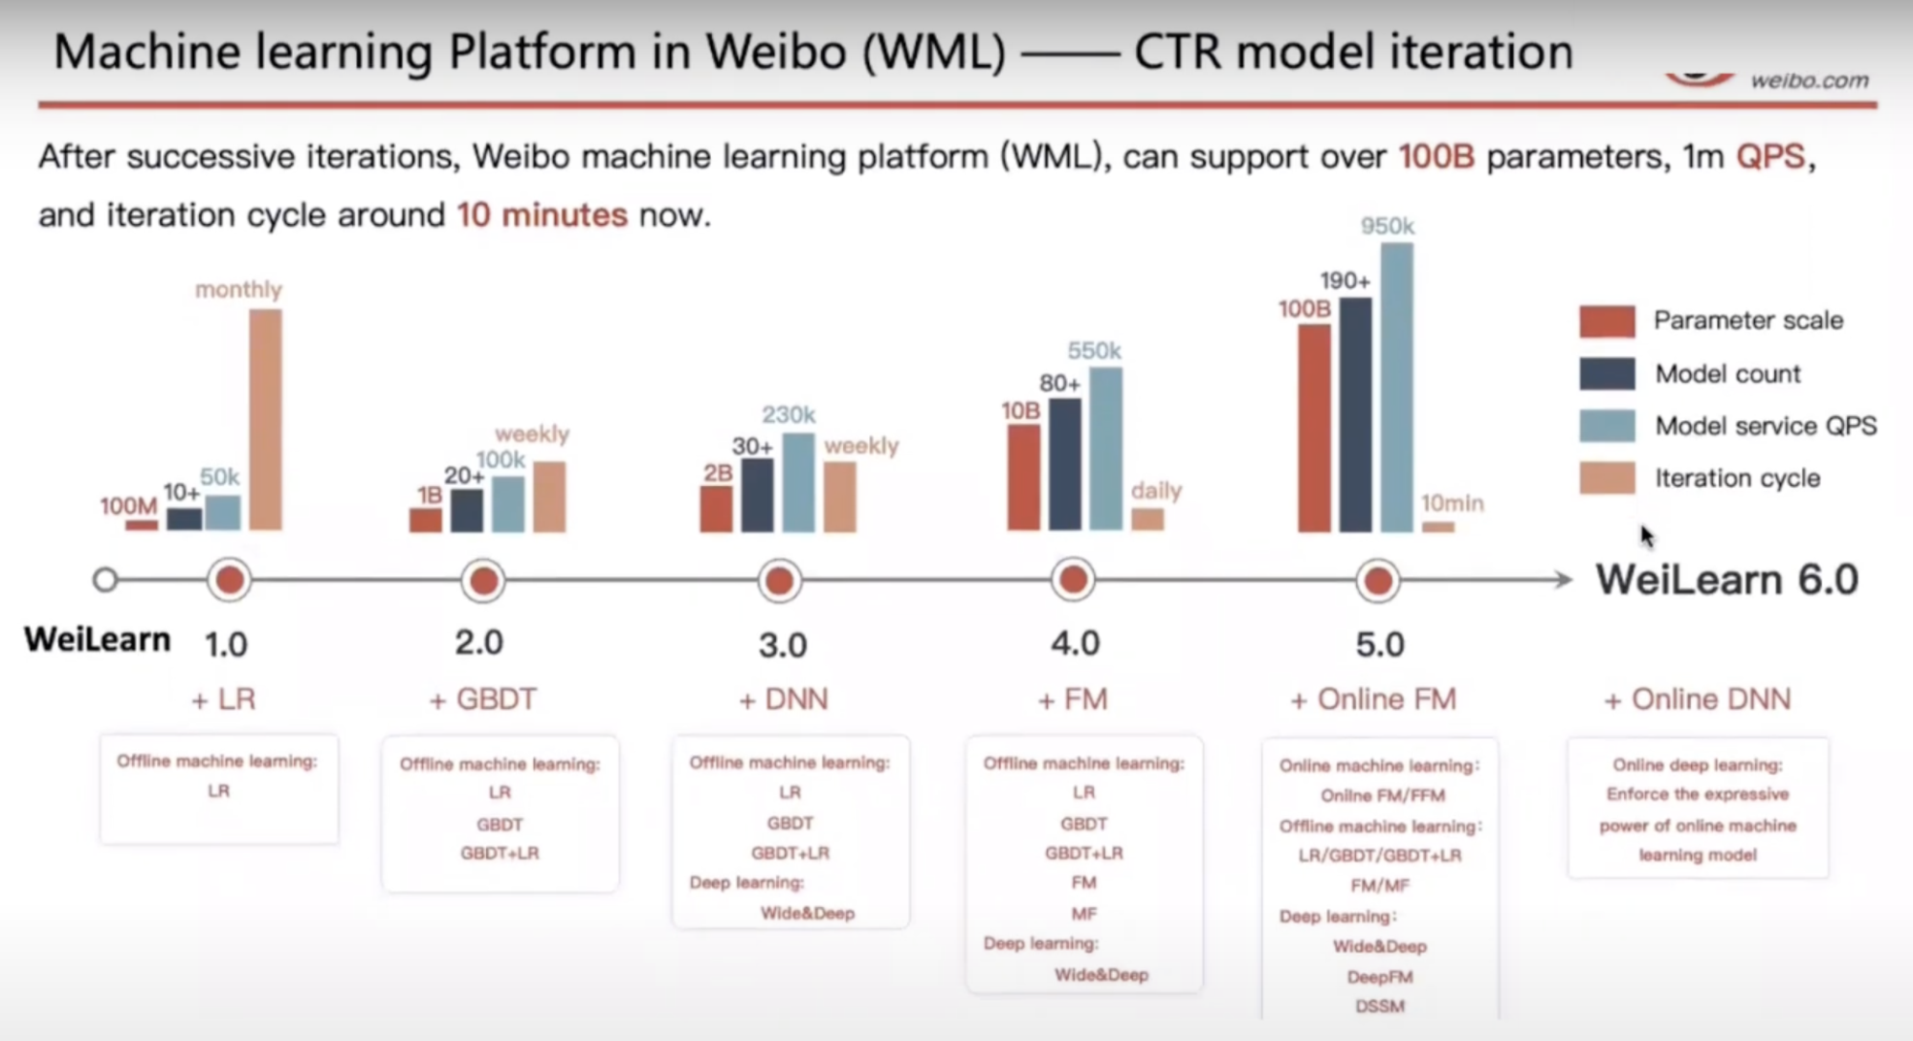
Weibo’s iteration cycle: 10 mins
Machine learning with Flink in Weibo (Qian Yu, QCon 2019)

Slide 62

ML + DevOps =

Slide 63
Myth #5: Most ML engineers don’t need to worry about scale

Slide 64
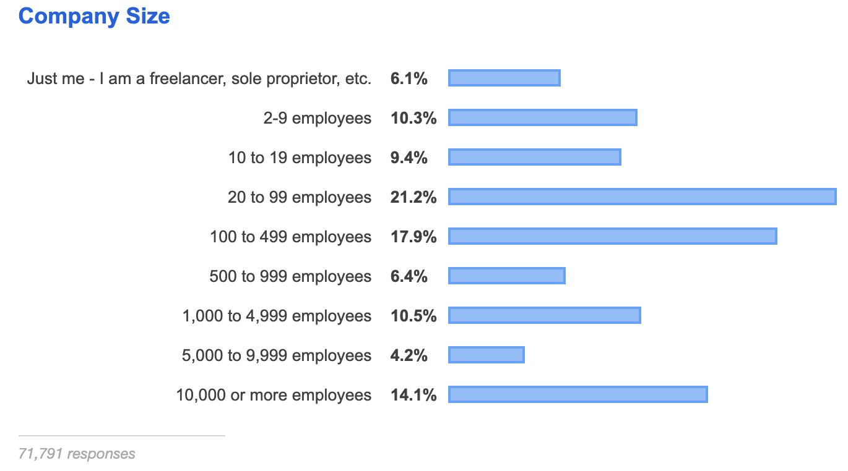
Myth #5: Most ML engineers don’t need to worry about scale
StackOverflow Developer Survey 2019

Slide 65
Myth #6: ML can magically transform your business overnight

Slide 66
Myth #6: ML can magically your business overnight
Magically: possible
Overnight: no

Slide 67
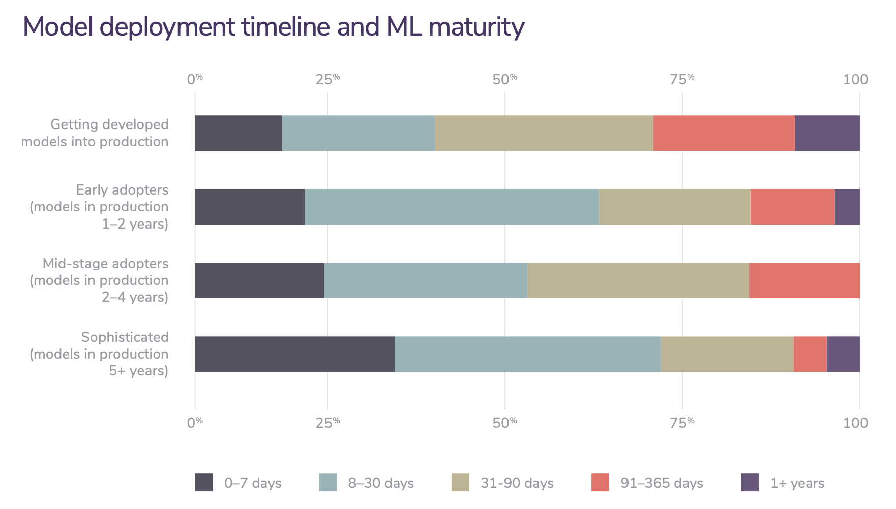
Efficiency improves with maturity
2020 state of enterprise machine learning (Algorithmia, 2020)
Notes:
The longer you’ve adopted AI, the faster your development cycle, the lower your engineering cost, and the higher your ROI will be. ML models suffer from this problem that the longer it takes a model to be deployed, the less effective it will be.

Slide 68





Notes:
Choose a random number from 1 to 10

Slide 69
Ishan got a head scratcher!
9 6 3 2 7
5 1 8 10 4

Slide 70
Machine Learning Systems Design
Next class: Designing an ML system
cs329s.stanford.edu | Chip Huyen

